Slide 1
Tree-Based Methods
© 2025 Virginia Polytechnic Institute and State University. All rights reserved.
Notes:
Welcome to our module on tree-based methods. Decision trees are useful for modeling many scenarios but more importantly they form the backbone of many more powerful techniques in machine learning such as random forests and gradient boosted machines. It is important to understand this basic concept so you can build upon it to understand more advanced tree-based modeling.

Slide 2
At the end of this module, you should be able to:
Identify when tree-based methods could be used
Describe the general ideas behind growing and pruning a tree
Describe the problem of overfitting
Understand the basic idea behind cost-complexity pruning
Define classification error and entropy
Describe the general procedures for bagging, random forests, and boosting
Implement basic tree-based methods in Python

Slide 3
Tree-Based Methods

Slide 4
Introduction to Machine Learning Course Roadmap
What is the goal of the data analysis?
Predict an output |  |  |  |  |  | Reveal patterns or relationships |  | Make decisions using an autonomous agent
Supervised Learning (Output in the data set) |  |  |  |  |  | Unsupervised Learning (No output in the data set) |  | Reinforcement Learning* (Supervised & unsupervised)
Continuous or discrete output? |  |  |  |  |  | What is the subgoal? |  | Does a model exist?
Continuous |  |  | Discrete |  |  | Identify groups | Reduce dimensions | Model Based | Model Free
Simple linear regression Multiple linear regression Subset selection Ridge regression & LASSO PCR & PLS | Polynomial regression Step functions Splines Local regression General additive models | Decision tree Random forest Neural network Gradient boosting tree | Logistic regression Linear discriminant analysis Quadratic discriminant analysis | Decision tree Random forest Neural network Gradient boosting tree | Support vector machines | Hierarchical clustering K-means clustering | Principal components analysis | Given the model Learn the model | Policy Optimization Q-Learning
Decision tree
Random forest
Decision tree
Random forest
Gradient boosting tree
Gradient boosting tree
*Advanced Topic: Bonus module if time
Notes:
In the previous module, we discussed supervised learning with a discrete or categorical response. Specifically we looked at parametric approaches for classification. Now we are going to look at nonparametric tree-based methods. Interestingly enough, tree-based methods are applicable for both “classification” with categorical outcomes and “regression” with continuous outputs .

Slide 5
Supervised versus unsupervised again
Some tangible measurement(s)
“The Black Box”
INPUTS
MACHINE LEARNING MODEL
OUTPUT(S)
Supervised Learning
In the context of domain knowledge
“The Black Box”
INPUTS
MACHINE LEARNING MODEL
PATTERNS,
RELATIONSHIPS, STRUCTURE
Unsupervised Learning
does it make sense?
Notes:
We want to provide you with some context of where tree-based methods fit into the larger scheme of machine learning. (click) Tree-based methods are supervised learning models. Recall, this means we have an output or response in the form of a dependent variable that we are trying to predict.

Slide 6
Supervised learning method selection is based on the response type
Is my response quantitative or qualitative?
Age
Height
Income
Stock Price
Tensile Strength
Quantitative
Qualitative
Blood Type
Default on Debt (y/n)
Cancer Stage
Brand Purchased
Species
Typically use regression method
Typically use classification method
Discrete: Nominal or Ordinal
Continuous Measures
What about the predictors?
For most methods, predictors can be
either quantitative or qualitative.
Notes:
Interestingly enough, tree-based methods are applicable for both numeric and categorical outcomes. You could model a numeric response like average income, and you could also model a categorical response such as default/non-default on debt.

Slide 7
Two methods of estimation
Parametric
(Less Flexible, More Interpretable)
Non-parametric
(More Flexible, Less Interpretable)
Inference focused
Select a model which involves an assumption about the functional form of f. Train the model and estimate parameters.
Example:
f is linear in X: f(X) = β₀+β₁X₁ + β₂X₂ +…+ β_{p}X_{p}
Prediction focused
Does not make explicit assumptions about the functional form of f. Can fit wider range of possible shapes for f, but at that cost of needing a larger number of observations.
Example:
Tree-based methods
Notes:
Tree-based methods fall into the category of non-parametric. We don’t have an assumption about the mathematical form of the model which allows us more flexibility but often means the models are less interpretable. However, basic decision tree-based models are fairly easy to interpret. You will see that the examples are much like reading a flowchart. Small trees are easy to follow and lend themselves to the creation of a series of rules for decision making. As the size of the tree increases, interpretability becomes more tedious. Their more complicated extensions such as random forests and gradient boosted trees are less interpretable.

Slide 8
Tree-Based Methods
Notes:
Decision trees are useful for modeling many scenarios but more importantly they form the backbone of many more powerful techniques in machine learning such as random forests and gradient boosted machines. It is important to understand this basic concept so you can build upon it to understand more advanced tree-based modeling.

Slide 9

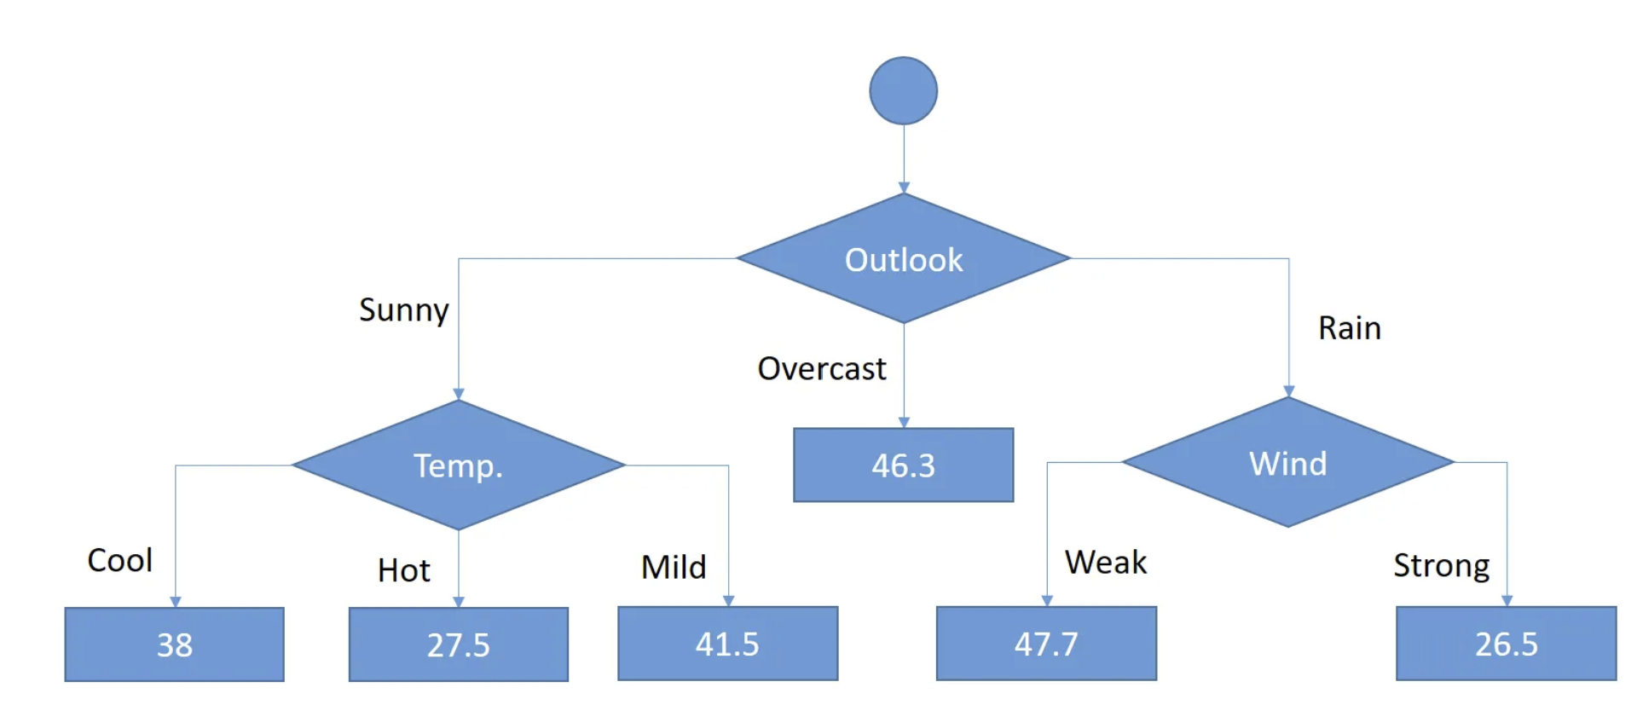
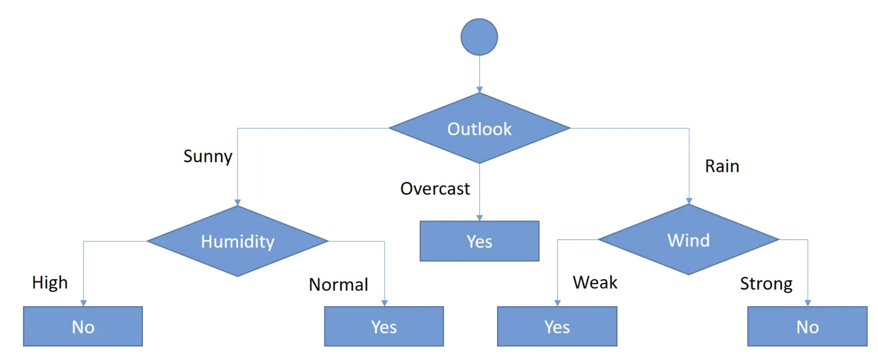

Will someone play golf or not?
How many golfers will be on the course?
Categorical Response:
Yes or No
Numeric Response:
Number playing golf on a given day
Figures from:
Serengil, SI. A Step by Step CART Decision Tree Example, Aug. 27, 2018
https://sefiks.com/2018/08/27/a-step-by-step-cart-decision-tree-example/
Serengil, SI. A Step By Step Regression Tree Example, Aug. 28, 2018.
https://sefiks.com/2018/08/28/a-step-by-step-regression-decision-tree-example
Notes:
Palatable examples of how we can use decision trees to solve both classification and regression problems. On the left is a classification problem, which we know because we are trying to predict a categorical response of yes or no, answering whether someone will play golf or not. The first variable of interest is the outlook or forecast, which splits the decision the model is making based on the predictors. If it will be sunny, then we need to also know humidity level to get an accurate prediction of yes or no.
Based on this, we can determine that someone will likely play golf if it is sunny and the humidity level is high. In other words, the effect that the forecast has on whether someone will play golf depends on the humidity level. That means there may be an interaction between forecast or outlook and humidity in predicting whether someone will play golf. We won’t go in depth on this but I just wanted to point this out because these decision tree models can be really useful in helping us identify potential interactions between predictors. Of course, more formal statistical tests are needed to confirm these interactions but these patterns help us to identify where interactions may exist.
On the right we see an example of a regression problem, indicated by a numeric or continuous response or outcome variable. Here, each of the lowest branches will either yield a specific value of prediction for that group of observations. In this example, we are predicting how many people will be on the golf course in a given day. Well we see that if the weather outlook is overcast, it predicts an average of 46.3 people will be golfing that day.

Slide 10
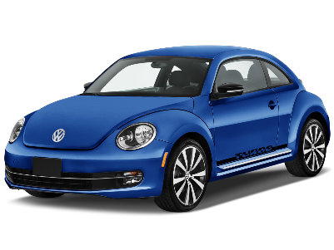
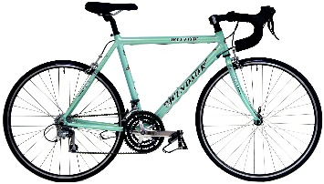



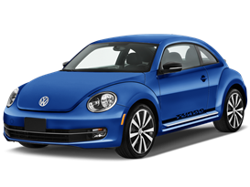

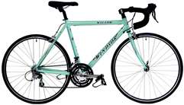

Everyday life decision tree
Bike or drive to work?
Weather Conditions?
Root Node
Branch
Temperature?
<60º
Meeting?
Internal Node
≥60º
No
Yes
Temperature?
Leaf Node or Terminal Node
<65º
≥65º
Notes:
This slide is helpful for understanding the verbiage we use for decision trees.
The root node is the first branch of the tree, in some cases, this will be the most important variable. Weather is pretty important for knowing whether to bike or drive to work for example because if it’s raining, riding a bike will definitely not be the move.
Each branch is usually indicated by diverging arrows and internal nodes are any variable that creates a branch in the tree without being the terminal node. In other words, internal nodes are inside the tree. Terminal nodes are important because these responses are used by the program to create the final prediction for a given set of data points. These nodes have no branches underneath them so in this slide, there are 6 terminal nodes. Leaf nodes or terminal nodes are those where the tree effectively ends, resulting in a decision in categorical case as illustrated here. If we were modeling numeric data, leaf nodes would result in ending in a numeric prediction.

Slide 11
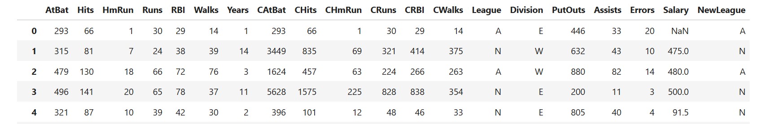
Regression trees
Suppose we want to predict a baseball player’s salary ($1000) based on the number of years that he has played in the major leagues and the number of hits that he made in the previous year
Notes:
Here is another reminder about the versatility of trees:
Decision trees can be applied to both regression and classification problems, we will begin by examining regression trees
Illustration: predicting a baseball player’s Salary (thousands of dollars) based on Years (the number of years that he has played in the major leagues) and Hits (the number of hits that he made in the previous year)
Emphasize that salary is the response
State that log salary will be used in analysis

Slide 12
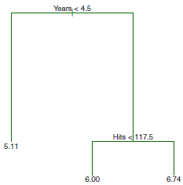

Regression tree for baseball salary
Years < 4.5
Region 1 (R1): < 4.5 years
Predicted Log(salary) = 5.11
Predicted Salary = $165,174
Region 2 (R2): > 4.5 years & < 117.5 hits
Predicted Log(salary) = 6.00
Predicted Salary = $402, 834
Region 3 (R3): > 4.5 years & > 117.5 hits
Predicted Log(salary) = 6.74
Predicted Salary = $845,346
Hits < 117.5
5.11
R₁
$165,174
6.00
6.74
R₂
R₃
$402,834
$845,346
Notes:
On this slide we see an example of a decision tree where we are predicting the salary for a baseball player based on the years played and the number of hits. Note this is a numeric response. The splits for this tree are shown based on years, followed by a second partition on hits.
The first split is based on Years, <4.5 years. The log of the average salary for players in the league for less than 4.5 years is 5.11. If we exponentiate that value, we see that the average salary for players with less than 4.5 years is $165,174. The predicted response is going to be the average of the actual y values taken from the training dataset in that terminal node. So in this Region 1 (R1) group of observations here, the model takes the average of the salaries in the training set since they are in the same predictive group and uses that average to predict that group’s salary in the test dataset.
The next split is based on hits, so those who have been playing for greater or equal to 4.5 years and made less than 117.5 hits last year, all players in the second region (R2) are predicted to have a log salary of 6.00 which back transforms to $402,834.
And in the third and final prediction region (R3), players who have been playing for greater than or equal to 4.5 years and made greater than or equal to 117.5 hits are predicted to have a log salary of 6.74 which back transforms to $845, 346

Slide 13
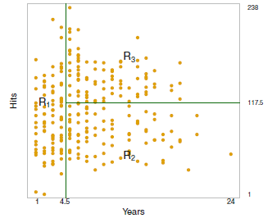
A different representation of the regression tree for baseball salary
Years < 4.5
=
Similar splits, just a different way of representation
Hits
Hits < 117.5
5.11
R₁
$165,174
6.00
6.74
Years
R₂
R₃
$402,834
$845,346
Notes:
Here we see two different ways of representing how the models predict different sets of observations.
The first split is based on Years, <4.5 years. The log of the average salary for players in the league for less than 4.5 years is 5.11. If we exponentiate that value, we see that the average salary for players with less than 4.5 years is $165,174. The predicted response is going to be the average of the actual y values taken from the training dataset in that terminal node. So in this Region 1 (R1) group of observations here, the model takes the average of the salaries in the training set since they are in the same predictive group and uses that average to predict that group’s salary in the test dataset.
The next split is based on hits, so those who have been playing for greater or equal to 4.5 years and made less than 117.5 hits last year, all players in the second region (R2) are predicted to have a log salary of 6.00 which back transforms to $402,834.
And in the third and final prediction region (R3), players who have been playing for greater than or equal to 4.5 years and made greater than or equal to 117.5 hits are predicted to have a log salary of 6.74 which back transforms to $845, 346

Slide 14
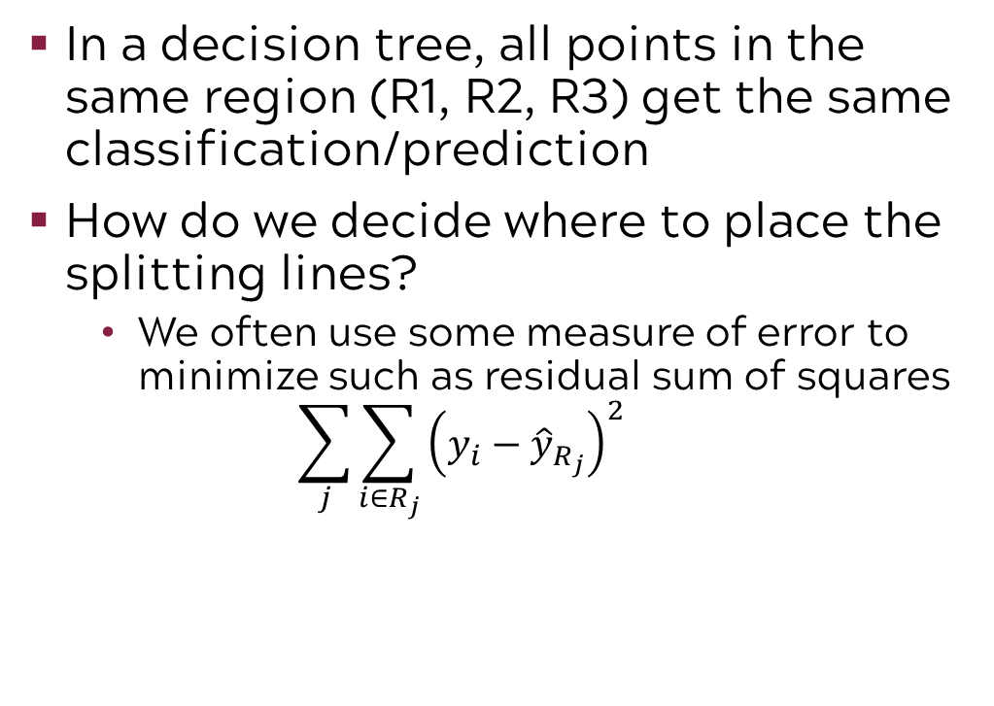
Splitting & predicting
$165,174
$845,346
In a decision tree, all points in the same region (R1, R2, R3) get the same classification/prediction
How do we decide where to place the splitting lines?
We often use some measure of error to minimize such as residual sum of squares
$$\sum_{j}{\sum_{i∈R_{j}}{{\left(y_{i}−{\hat{y}}_{R_{j}}\right)}^{2}}}$$
The actual value of an observation
The prediction / classification given by a proposed scheme
$402,834
Notes:
Just as a reminder: In a decision tree, all points in the same region (R1, R2, R3) get the same classification/prediction
How do we decide where to split the tree? You might phrase this alternatively as how do we decide where to place the lines that define the regions for prediction. We place them in a way to minimize error or errors in classification. At this time, we will discuss how to split for a numeric response. We base those splits on minimizing the residual sum of squares. Recall from regression that this is (actual – predicted) squared. We find both the variable and the value of the variable that results in the smallest over residual sum of squares and that algorithm is repeated over and over again. Residual sum of squares is a measure of the total amount of error your predicted values have.

Slide 15
Tree-Based Methods

Slide 16



There are many ways to grow a tree
Often infeasible to try all the trees
How do we know which tree is the best?
Use greedy algorithms called Recursive Binary Splitting
Greedy algorithms make the choice which seems to be the best at each stage of splitting
Tree1
Tree2
Tree3
Tree4
Tree5
Notes:
The process of creating a tree is called growing a tree. As you might imagine, there are almost infinite possibilities for creating trees. It would certainly be infeasible to test all of them or even the vast majority of them for a given data set. So, how do we know which tree is best? We use something called a greedy algorithm. Greedy algorithms make the choice that seems to be the best at that moment. These algorithms focus on a finding a local optimum in the hopes that this will lead to a global optimum. For decision trees, this means they choose the split that is best at each stage. The greedy algorithm for decision trees is called recursive binary splitting. This algorithm will locally optimize objective functions such as information gain, entropy, and residual sums of squares in order to split. We will discuss some of these objective functions at later points in our discussion of trees.
In other words, these algorithms tend to come up with suboptimal solutions from a limited field of view.
https://www.hackerearth.com/practice/algorithms/greedy/basics-of-greedy-algorithms/tutorial/
https://www.geeksforgeeks.org/greedy-algorithms/

Slide 17
Recursive binary splitting steps
Find the best split
Examine all possible splits for every variable (X₁, X₂, …, X_{n}). Determine which split minimizes error expression.
Continue examining all remaining variables as candidates for the second split
Repeat the process until no more variables are left or until some established stopping rule is satisfied.
X₁
X₂
X₃
X_{n}
…
Then, the next best split
…
X₁
X₃
X_{n}
…
Node has minimum number
Or other stopping rules are met.
X_{i}
Cannot be split further
Notes:
Recursive binary splitting starts by examining all possible splits for every variable in the data and determines which split minimizes error. Then, the algorithm examines the remaining variables and determines the next best split. This process is repeated until all variables have been split on or until some established stopping rule is satisfied.

Slide 18

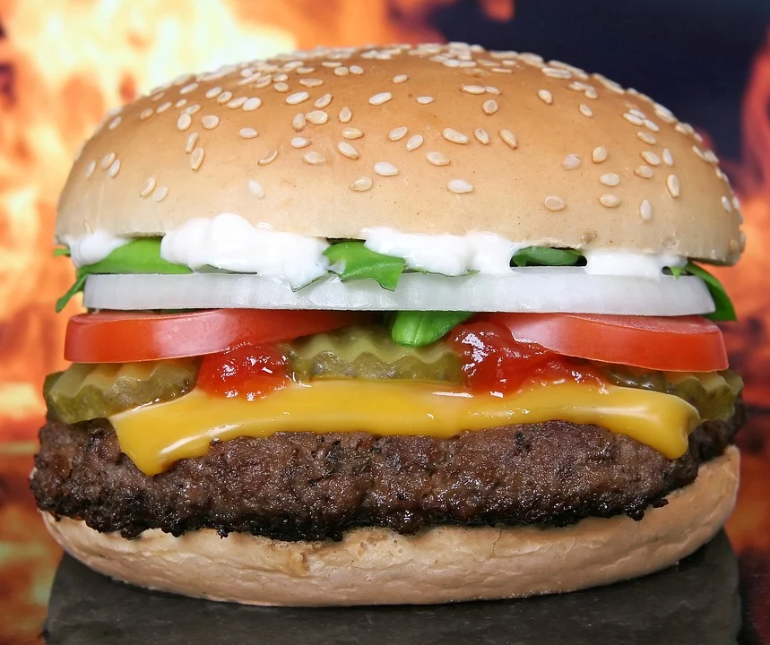


Greedy algorithms have an obvious drawback: May only find local optimum
My ranked food preferences:
Burger and Fries
Burger and Onion Rings
Pizza
Just a burger
I choose Pizza!
My favorite choices have been missed!
Hmm… Neither are my favorites.
Notes:
Greedy algorithms have some drawbacks. If you consider my ranked food preferences as
Burger and Fries
Burger and Onion Rings
Pizza
Just a burger
A greedy algorithm in this case would always choose from the left side of this tree because it starts by comparing pizza to burger, so it completely misses my preference ranking
This is a great example of how using a greedy approach can lead you astray from finding the most accurate predictions for your data overall by focusing on the best splits for that specific situation rather than focusing on the best splits overall. It leaves you with a sub-optimal solution based on a limited field of view, a best choice locally but not globally
https://toppng.com/pizza-PNG-free-PNG-Images_54446?search-result=pizza-up
https://toppng.com/onion-rings-png-onion-ri-PNG-free-PNG-Images_295114?search-result=cute-onion
https://toppng.com/onion-rings-png-onion-ri-PNG-free-PNG-Images_295114?search-result=cute-onion
https://www.pngitem.com/middle/bJRTmb_transparent-png-burger-png-transparent-background-burger-sandwich/

Slide 19
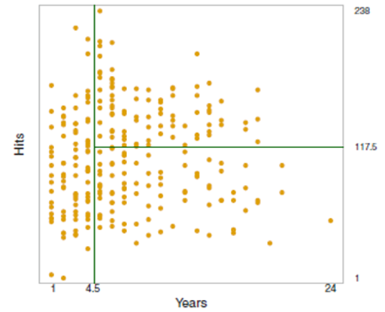
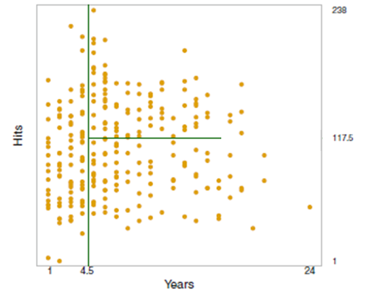
Another drawback of greedy algorithms is that some splits are impossible
Viable Split
Impossible Split
238
238
Hits
Hits
117.5
117.5
1
1
1
4.5
Years
24
1
4.5
Years
24
Notes:
Another drawback is that greedy algorithms work in such a way that some splits are impossible. They only allow binary splits at each node.
Figure is an outcome of Decision Tree using Recursive binary splitting. The left figure shows a possible outcome. The green lines represent each split. Each time the split needs to be complete, reaching from one end to the other.
The right panel is impossible because the green line does not split the data straight to the end, which can’t be done by binary split. It does the first split based on the number of years in the league, but then when it comes to the second split, it doesn’t go all the way down to the end, rather splitting it into three sections, which is impossible for recursive binary splitting even if it makes more logical sense. .

Slide 20
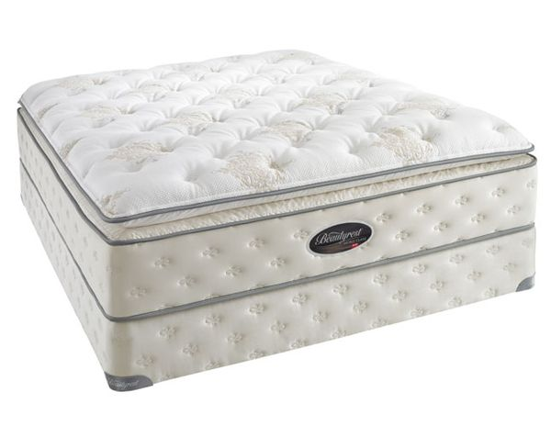
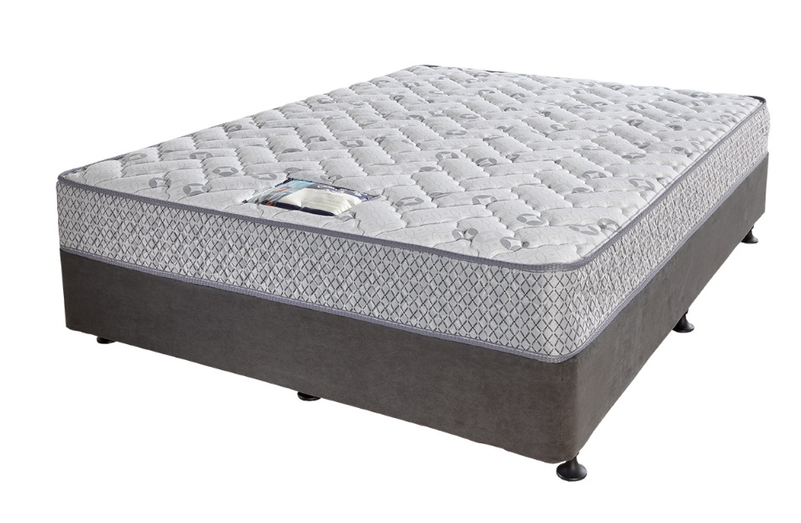
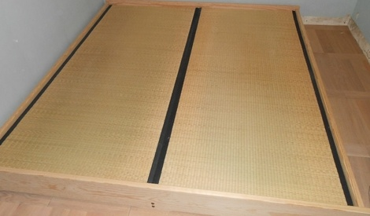
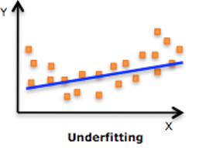
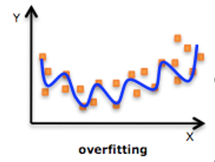
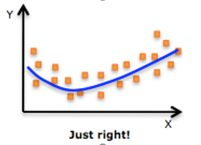
Decision trees are flexible but often overfit
This bed is too hard!
This bed is too soft!
This bed is just right!
Notes:
Decision trees seem like versatile machine learning methods; they work for both regression and classification, and they are easy to implement, explain and interpret. The main reason we don’t use trees for everything is overfitting.
Overfitting is likely to occur when you have a very flexible model that can incorporate the smallest details into its predictions.
Each observation is likely to be unique in some way, overfitting causes the model to be highly influenced by very small differences (Recall the bias-variance trade-off.)
An extreme case is when it creates a region/prediction for each individual data-point. Such a model will perfectly predict/classify the data-points it has encountered before, but will perform poorly when faced with data that are marginally different, as each minor difference can completely alter an observation’s classification/prediction
Goldilocks and the Three Bears analogy: We don’t want to underfit or overfit our model.

Slide 21
An extreme case of overfitting
Training Data – Overfit with One Observation Per Node
Add in Test Data – Lots of Misclassifications
Category 1
Category 2
Category 1
Category 2
Notes:
An extreme case is when it creates a region/prediction for each individual data-point. Such a model will perfectly predict/classify the data-points it has encountered before, but will perform poorly when faced with data that are marginally different, as each minor difference can completely alter an observation’s classification/prediction.
In the picture on the left, the training data, denoted by circles, is classified with one observation in each split. The solid circles belong to category 1 and the open circles belong to category 2. In the picture on the right, we add in the real data, denoted by triangles. If the model were mostly accurate, we would see solid triangles in the same splits as the solid circles and we would see open triangles in the same splits with open circles. Instead we see a lot of open triangles with solid circles and vice versa. This indicates our model did not perform well on the real data.

Slide 22

To avoid the problem of overfitting in decision trees, we perform tree pruning
Tree pruning involves limiting the size of the tree, so as not to have too many regions/terminal nodes (i.e. to avoid having splits based on minor differences)
Notes:
Just like you prune trees in real life to keep them from growing out of control, we prune trees in machine learning. Pruning means we limit the size of the tree to avoid overfitting and having too many regions or terminal nodes with splits based on minor differences.
One way of doing that is to grow a very large tree and select/extract the subtree which leads to the lowest errors
There are many ways of doing this, we will examine a pruning method known as Cost Complexity Pruning (also known as weakest link pruning)

Slide 23
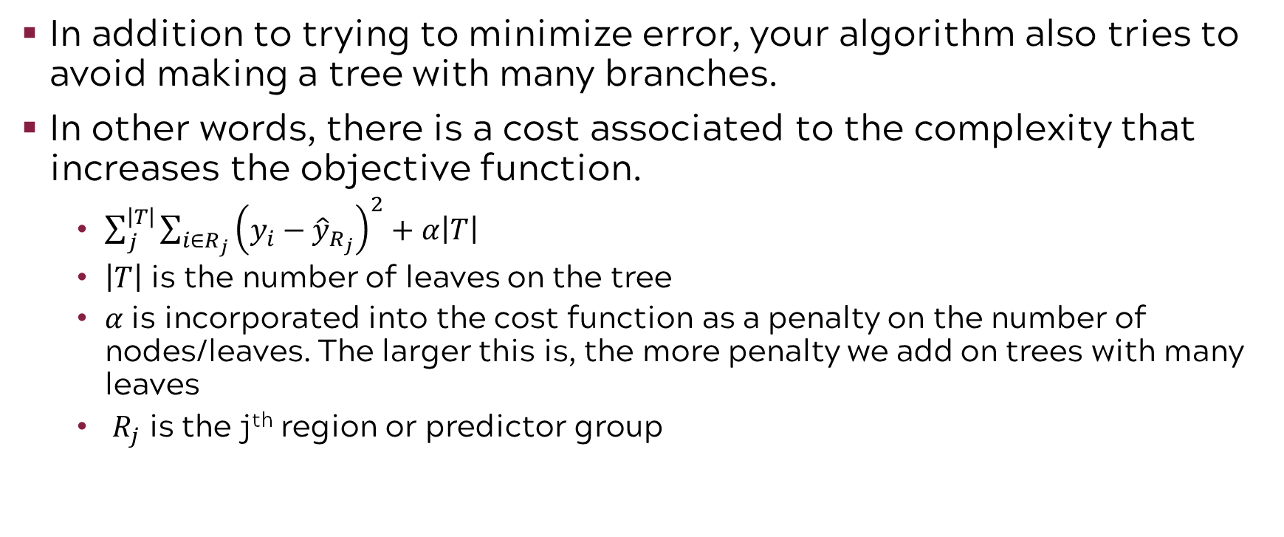
Cost complexity pruning minimizes error with a tree that has as few branches as possible
In addition to trying to minimize error, your algorithm also tries to avoid making a tree with many branches.
In other words, there is a cost associated to the complexity that increases the objective function.
$\sum_{j}^{\left|T\right|}{\sum_{i∈R_{j}}{{\left(y_{i}−{\hat{y}}_{R_{j}}\right)}^{2}}}+α\left|T\right|$
$\left|T\right|$ is the number of leaves on the tree
𝛼 is incorporated into the cost function as a penalty on the number of nodes/leaves. The larger this is, the more penalty we add on trees with many leaves
$R_{j}$ is the j^{th} region or predictor group
Notes:
We assign a new non-negative parameter 𝛼, this new parameter will be incorporated into our cost function as a penalty (recall the penalty in Lasso and Ridge Regression) - go though error term
the more terminal nodes your tree has (i.e. the larger and more complex it is), the more your error function increases
Now, your algorithm is not only trying to minimize error, it’s also trying to avoid making a complicated tree with many branches. Recall our earlier error function:

Slide 24
Cost complexity pruning steps
Grow a very large tree with many leaves
Stop growing the tree when number of datapoints in each leaf is less than a number you specify
Notes:
To do this we, grow a very large tree with many leaves but we stop it when the number of data points in each leaf is less than a specified number.

Slide 25
An example decision tree with stopping rule of 3 data points in each leaf or predictive group
Category 1
Category 2
Notes:
This example had a pre-specified number of 3, such that when there were less than 3 data points in each leaf or predictive group, the tree stopped splitting. So the tree kept splitting kept splitting, then oh, it looks like this group only has 3 data points, now we can stop splitting, or this group now has 2 data points, which is less than 3, so we should stop splitting to avoid overfitting to one specific data point.

Slide 26

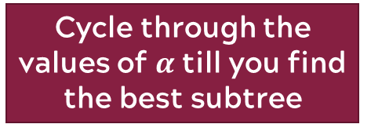
Cost complexity pruning steps
Grow a very large tree with many leaves
Stop growing the tree when number of datapoints in each leaf is less than a number you specify
Select a value for $α$
From your large tree, extract the subtree that yields the smallest cost
Cycle through the values of $α$ till you find the best subtree
Notes:
Once we stop growing the tree, we then select a value for our penalty on the number of nodes and leaves to evaluate our cost function. Then we take our large tree and extract the subtree that yields the smallest cost. This involves cycling through values of penalties to find that best subtree. This is accomplished via cross validation.
So to choose the optimal value for alpha, our penalty parameter, we are going to divide our training data into K folds, most often people will use 10 folds.
Then it will repeat steps 1 and 2, trying to minimize the error by adding a value for alpha to the cost function.
Then the algorithm will evaluate the mean squared prediction error on the data in the last fold, for example the 10th fold as a function of alpha. Remember each alpha is associated with one subtree so each value for alpha yields a different mean squared error.
Finally, it will average all the results from those 9 folds where it tried to minimize the error while choosing different values for alpha and pick the value for alpha that minimized the error the most, while penalizing trees that have more terminal nodes.

Slide 27
Tree-Based Methods

Slide 28
Review of decision tree nomenclature
ROOT Node
Subtree
This is a split.
Decision Node
Decision Node
Terminal Node
Terminal Node
Terminal Node
Decision Node
Terminal Node
Terminal Node
https://www.kdnuggets.com/2020/01/decision-tree-algorithm-explained.html
Notes:
Point out root node, decision nodes where further splits occur and terminal node as last node in the tree where the classification occurs
Point out subtree as a portion of the tree

Slide 29

Recall that regression trees assign a prediction by averaging the values of observations sharing a terminal node
Data values in this node
{ 52 61 63 64 65 66 67 67 68 69 69 70 70 70 71 72 }
THE MEAN = THE AVERAGE
Calculate the average of all the data in the node
= 1064/16
Prediction for circled node = 66.5
Notes:
Recall: A regression tree assigns the average value of observations sharing a terminal node as the predicted value for that node

Slide 30
A classification tree works by voting: The most popular category wins!
Every data point in the circled node is predicted as Category 3 because it has 72% of the observations in it belonging to Category 3.
Notes:
In contrast, a classification tree works by “voting”, meaning it assigns a predicted classification to a certain terminal node based on the most commonly occurring class in that node
Point out the bar graph as the distribution of categories of observations that follow a branch of the tree down to the terminal node. Using an example might help here.

Slide 31
Category 1 wins in this node
Every data point in the circled node is predicted as Category 1 because it has 95% of the observations in it belonging to Category 1.
Notes:
In contrast, a classification tree works by “voting”, meaning it assigns a predicted classification to a certain terminal node based on the most commonly occurring class in that node
Re-emphasize bar graph as the distribution of categories of observations that follow a branch of the tree down to the terminal node. Using an example might help here.

Slide 32


Recall the confusion matrix is used to assess accuracy and error in a classification setting
Actual or True
Goal is to maximize accuracy and minimize error
Diagonal entries represent accurate predictions (i.e., Predicted Class = Actual Class)
Off diagonals represent misclassification (i.e., Predicted Class ≠ Actual Class)
Category | A | B | C | D
A
B
C
D
Predicted
Notes:
As we have shown earlier, when working with classification problems we often use accuracy and error as our measures of fit. Classification trees are no different.
Here is a simplified confusion matrix where we can understand how the model is performing in terms of classification and misclassification, we have the actual classifications for our observations on this axis and the predicted classifications of our observations on this axis.
We want our predicted values to be in sync with the actual values, so in other words, we want the diagonals to be the same such that if the actual category is A, our predicted classification should also be category A, but we don’t want those who are actually in category C for example to have been predicted to be in category B.

Slide 33
Classification error rate is the percent misclassified in the training set
Classification Error Rate:
9.2 + 8.3 + 10.5 = 28%
3
72% correctly classified
Notes:
Remember how for regression trees we talked about residual sum of squares and how in each split, the algorithm chooses how to split at each variable by trying to minimize the residual sum of squares? Well in classification problems, the algorithm cannot use residual sum of squares, and it instead uses this metric called classification error rate
So our classification error in a given region/terminal node/leaf is simply the fraction of the training observations in that region that do not belong to the most common class.
So 9.2 percent belong to category 4, 8.3 percent belong to category 2, and 10.5 percent belong to category 1, sum those up and you get a classification error rate of 28 percent meaning 28% of the observations were misclassified.
So for a higher classification error rate, like this one, the tree will probably split again to minimize this error

Slide 34
In this node, the classification error is 5%
Classification Error Rate:
2.5 + 1.2 + 1.3 = 5%
1
95% correctly classified
Notes:
Here the classification error rate has been minimized.

Slide 35
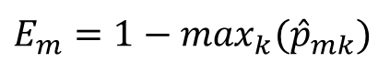
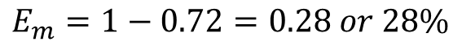
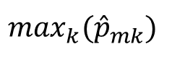
Another way to calculate classification error
Classification Error
$$E_{m}=1−\max_{k}({\hat{p}}_{mk})$$
Classification error in the m^{th} terminal node
proportion of observations in the m^{th} node from class k
$$\max_{k}({\hat{p}}_{mk})$$
The is 0.72, converted from 72%.
$$E_{m}=1−0.72=0.28 or 28\%$$
Notes:
Another way to calculate classification error is by simply looking at the percentage of observations that do belong to the majority category and then subtract that from 100.

Slide 36
Node purity means superior classification quality!
ROOT Node
Pure nodes are the goal, but we don’t want to overfit!
Decision Node
Decision Node
Terminal Node
Terminal Node
Terminal Node
Decision Node
+
+
-
+
+
+
+
+
+
-
+
+
-
+
+
+
+
+
+
+
-
-
Terminal Node
Terminal Node
100% Pure - Homogenous classification!
Impure Node – Classification not homogenous.
Notes:
So it turns out that classification error rate is not the best way to grow trees. Why? Because if we continue to focus on minimizing classification error, we will end up with very pure nodes.
Here is an example of a pure terminal node, where only identical observations exist. Theoretically, we could create a tree with perfect accuracy and purity in each node by continuing to split (assuming our data has this complete predictive power). Would that be helpful? NO. Why? Overfitting! We know that overfitting will lead to poor prediction performance on future data. So, pure nodes are the goal but we want to control for overfitting.
Entropy is an alternative metric that keeps us from overfitting!

Slide 37
From physics, entropy is the degree of chaos or disorder in a system
Low Entropy
High Entropy
Notes:
We are going to apply the idea of entropy to the amount of disorder or order in the terminal nodes of our trees. Low entropy is indicative of order, good separation, while high entropy is indicative of chaos, poor separation low purity of terminal nodes.

Slide 38
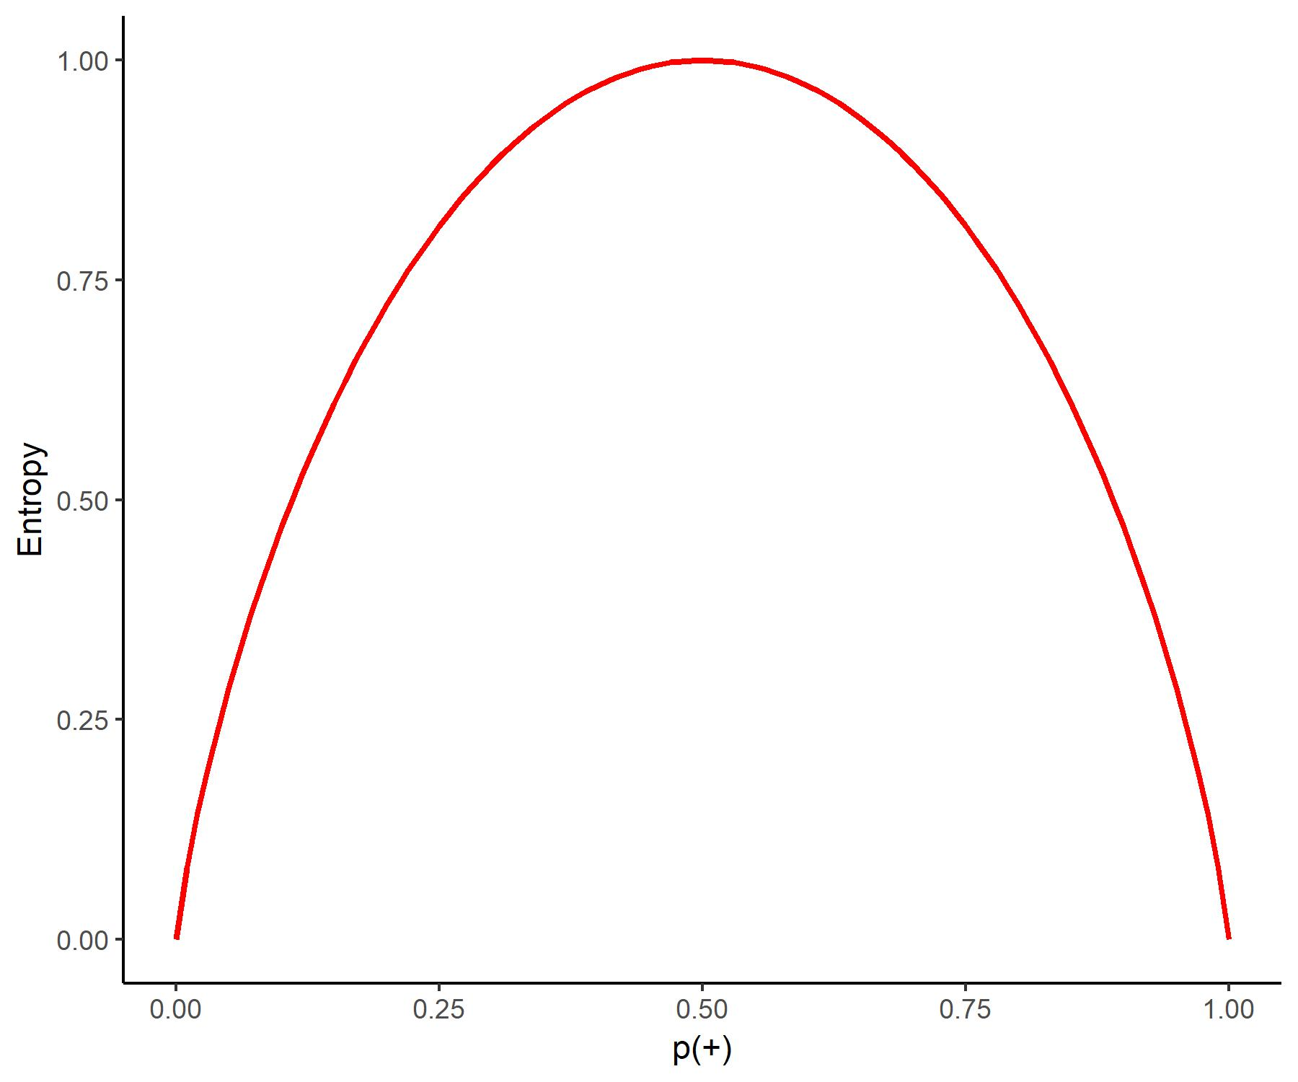
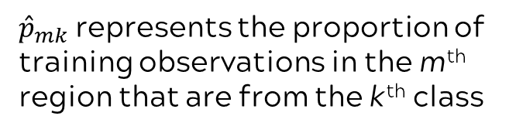
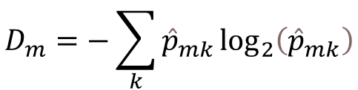
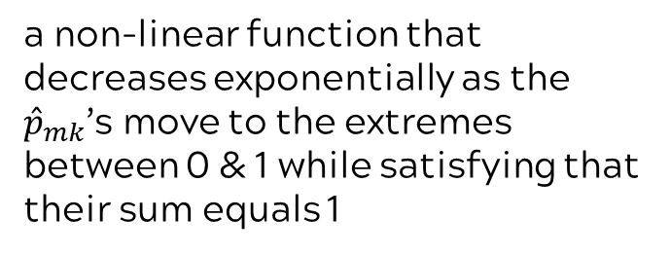
A graph of entropy for two categories (-, +)
Entropy
$$D_{m}=−\sum_{k}{{\hat{p}}_{mk}\log_{2}\left({\hat{p}}_{mk}\right)}$$
-
+
+
+
-
-
+
+
+
Entropy in the m^{th} terminal node
-
-
-
a non-linear function that decreases exponentially as the ${\hat{p}}_{mk}$’s move to the extremes between 0 & 1 while satisfying that their sum equals 1
-
+
-
+
+
+
+
-
-
-
-
+
-
+
+
+
-
+
-
+
-
-
-
-
-
${\hat{p}}_{mk}$ represents the proportion of training observations in the m^{th} region that are from the k^{th} class
-
-
+
+
-
-
-
+
+
+
-
-
+
+
-
+
+
-
-
-
+
+
+
$p_{+}$ = proportion of observations that belong to + class
Notes:
We will use the simple example of a two category classification tree to more formally define entropy. On the vertical axis we have entropy. On the horizontal axis we have the proportion of positive classifications. You could think of them as “yesses”. For example, this might represent the proportion of people that choose to drive a car to work (as opposed to riding a bike). Entropy is minimized when the node is pure, all positives or “yesses”. In the middle of the graph, you see varying degrees of node purity with the maximum entropy at the 50/50 node
The mathematical details on the right show that entropy is composed of a non-linear function that decreases exponentially as the 𝑝 ̂_𝑚𝑘’s move to the extremes between 0 & 1 while satisfying that their sum equals 1

Slide 39
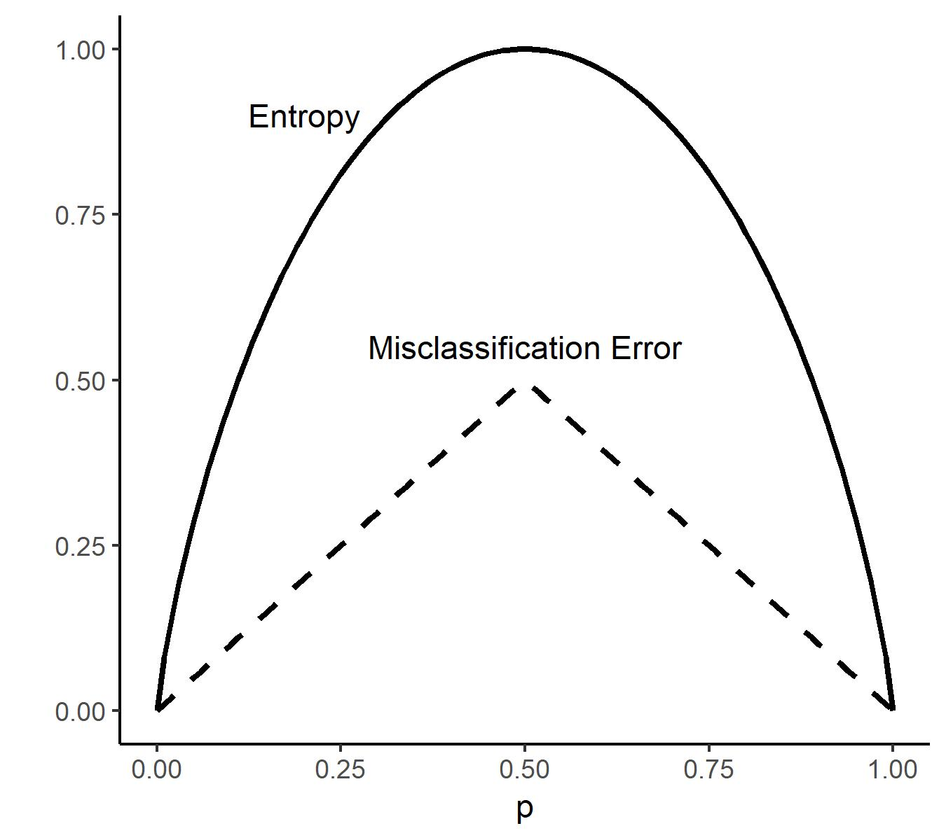
Entropy is more sensitive than classification error rate
Remember:
Lower is better for both metrics!
Entropy penalizes overfitting!
https://www-users.cs.umn.edu/~kumar/dmbook/ch4.pdf
Notes:
So again, p represents the proportion of observations in a terminal node that are in a certain class. If 50 percent of the observations in a terminal node belong to one class, that means that 50 percent of observations are going to be misclassified, which means the model is predicting at a chance level, which is terrible. That means that entropy and classification error rate will both be the highest, but you can see that entropy is much more sensitive to nodes like this that are very impure, giving it a much higher value.
Remember that high entropy and high classification error rate are both bad and entropy penalizes overfitting as well. We’ll see some examples of how both of these work in the next slide.

Slide 40
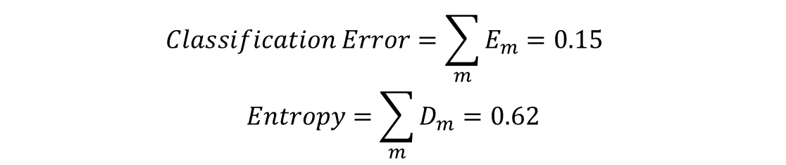
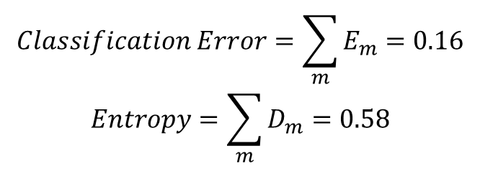
Entropy favors purity
Classification Error Rate lower for this tree.
Entropy lower for this tree.
Root Node
This node is really pure!
Root Node
Terminal Node
Terminal Node
Terminal Node
Terminal Node
(0.90, 0.05, 0.05)
(0.04, 0.95, 0.01)
(0.99, 0.005, 0.005)
(0.10, 0.85, 0.05)
$$Classification Error=\sum_{m}{E_{m}=0.15}$$
$$Entropy=\sum_{m}{D_{m}=0.62}$$
$$Classification Error=\sum_{m}{E_{m}=0.16}$$
$$Entropy=\sum_{m}{D_{m}=0.58}$$
m = number of terminal nodes
Notes:
So in this tree on the left, here, you can see that in this terminal node, about 90 percent of the training data belongs to one class and so about 10 percent of the data will be misclassified here. In this terminal node, about 5 percent of the observations will be misclassified.
In this tree on the right, this terminal node is the most pure because about 99 percent of the data in this node belong to one class and only 1 percent is misclassified.
Classification error (that’s E) would suggest that the tree on the left is the better one, but entropy (signified by D) is favoring the tree on the right because this terminal node is so pure even though it still penalizes overfitting in real-world applications. Repeat what m and k are.

Slide 41
Entropy and classification error rate for a 3-level classification problem
Note that, unlike error classification rate, entropy does not have an upper bound of 1 in all cases.
2 classes: Max entropy is 1
4 classes: Max entropy is 2
8 classes: Max entropy is 3
16 classes: Max entropy is 4
Etc.
Predicted Class Probabilities | Entropy | Classification Error Rate
(0.34, 0.33, 0.33) | 1.10 | 0.66
(0.75, 0.20, 0.05) | 0.69 | 0.25
(0.99, 0.005, 0.005) | 0.06 | 0.01
Notes:
Here is an example of entropy juxtaposed with classification rate from our previous module for a three level classification problem with varying levels of node purity. Notice that entropy seems to penalize impure nodes more than pure classification error. In the first row, it is predicted that 66 percent of observations will be misclassified, which gives an entropy values of 1.10, notice that this is higher than 1 because there are three categories. Entropy then goes down as the nodes become purer, with 25 percent being misclassified in the second row and one percent being misclassified in the third row. Classification error rate also progressively decreases as misclassification decreases, but to a much smaller degree, showing how much more sensitive entropy is.
When we get to the case of predicting a response with more than 2 responses, entropy is no longer bounded by 0 and 1 and can go beyond 1. In the case of 4 classes, entropy can go as high as 2, for 8 different categories, entropy can go as high as 3 and for 16 categories, it can be as high as 4.

Slide 42
Why do you care about purity and entropy?
Entropy can keep us from overfitting.
Entropy is used in the calculations of many algorithms to determine if a split improves the quality of the model.
You might hear it used in conjunction with Information Gain or Gain Ratio in terms of tree algorithms.
Notes:
Even though entropy favors node purity, it can keep us from overfitting and is used by many algorithms to determine if a split improves the quality of the model.
Information gain measures the entropy we removed by adding a split in the tree, and the algorithm will work to maximize information gain.

Slide 43
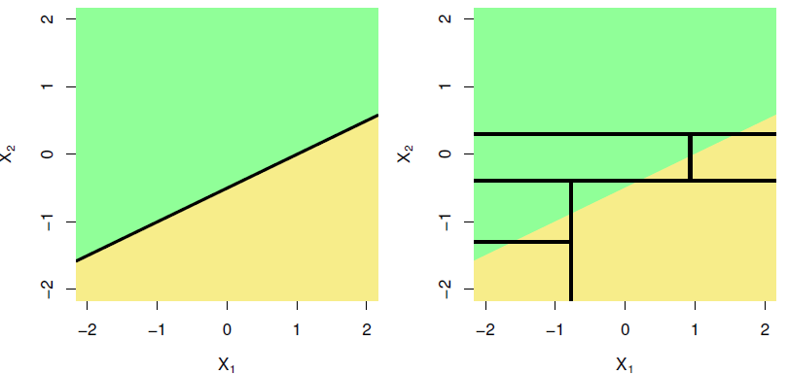
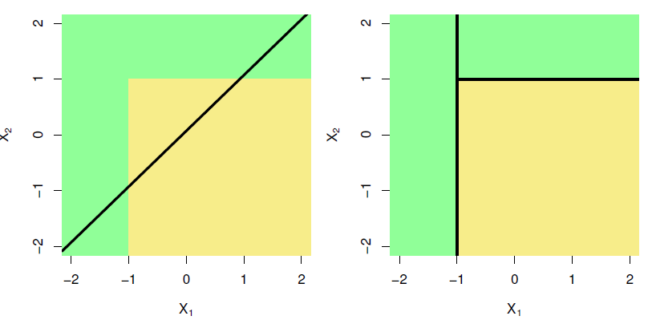
Trees vs. Linear Models
When the decision boundary (divider between green-yellow) is linear, it is naturally better approximated by a linear model
Linear model performs better
Tree performs better
Notes:
Recall: Decision trees are simple to implement and interpret, and are very flexible; why would you ever choose a linear model over a decision tree?
It depends on the process you’re examining and the kind of boundaries it produces. Consider the below classification example:
Left pair: A two-dimensional classification example in which the true decision boundary is linear, and is indicated by the shaded regions. A classical approach that assumes a linear boundary (left) will outperform a decision tree that performs splits parallel to the axes.
Right pair: Here the true decision boundary is non-linear. Here a linear model is unable to capture the true decision boundary (left), whereas a decision tree is successful (right).

Slide 44
Pros and cons of decision trees
Pros
Cons
Very easy to explain
May more closely mirror human decision-making
Can be displayed graphically, and are easily interpreted even by a non-expert (especially if they are small)
Can easily handle qualitative predictors
Generally do not have the same level of predictive accuracy as some other approaches
Can be very non-robust
Notes:
Pros:
Trees are very easy to explain to people. In fact, they are even easier to explain than linear regression!
Some people believe that decision trees more closely mirror human decision-making than do the regression and classification approaches seen in previous chapters.
Trees can be displayed graphically, and are easily interpreted even by a non-expert (especially if they are small).
Trees can easily handle qualitative predictors without the need to create dummy variables.
Cons:
Unfortunately, trees generally do not have the same level of predictive accuracy as some of the other regression and classification approaches seen in this book.
Additionally, trees can be very non-robust. In other words, a small change in the data can cause a large change in the final estimated tree.

Slide 45
Tree-Based Methods

Slide 46
How deep should a decision tree grow?
Too simple (Underfitting)
Maybe just right!
Too complicated (Overfitting)
1
1
0
1
1
1
0
1
0
0
0
1
0
0
1
0
1
0
1
0
1
0
1
0
...
...
0
1
0
0
1
0
1
1
0
1
High bias, Low variance
How confident can you be about this tree, though?
Low bias, High variance
use
Bagging
Random forests
Boosting
Notes:
Underfitting is usually associated with high bias and low variance. This means we are getting less accurate predictions because we are making fewer distinctions between predictions across observations.
Overfitting is usually associated with low bias and high variance, so we are making a lot of predictions, maybe even one prediction per data point, which is not what we want because it won’t perform well when we introduce new data to the model.
We aim to find the right fit using methods such as bagging, RF, Boosting, which use a large amount of smaller trees averaged together, rather than creating one large tree that may inflate the variance.

Slide 47
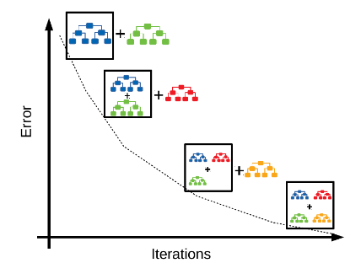
Techniques to overcome problems including overfitting and variance for trees
Bagging | Random Forest | Boosting
Obtain bootstrap sampled data from original data Fit a tree for each sample data | Obtain bootstrap sampled data from original data Fit a tree for each sample data Limit the number of variables to consider in each split | Grow trees sequentially Start by growing one tree, extracting its residuals, then fitting a second tree to those residuals, etc.
Notes:
Decision-trees are the building blocks for these more complex models that use more than just one tree. To overcome a host of problems that decision trees have including overfitting and variance for our trees, we use these iterative techniques that create many smaller trees rather than a single tree with high variance, improving the accuracy of these models to the point where they can now compete with other well-performing predictive models we discuss in this class.
Here is a brief overview of bagging, random forest, and boosting. Bagging relies on the concept of bootstrapping. Bootstrapping involves taking multiple samples from your training data and fitting multiple trees. These trees are then used in combination to make predictions. Random forests use bootstrapping as well. They fit a tree to each bootstrapped sample but add a limitation to the number of variables we can consider at each split. Boosting involves creating trees sequentially, the second tree is fit on the residuals from the first, the third tree is fit on residuals from the second and so on and so forth.
Now, I will just go into depth for each of these techniques so we can understand a little bit more about how they work.
Picture reference:
Block-distributed Gradient Boosted Trees (tvas.me)

Slide 48
Bagging
A | B | C | D | E | F | G
53 | 23 | 47 | 74 | 52 | 55 | 26
68 | 0 | 69 | 92 | 52 | 73 | 27
53 | 23 | 47 | 74 | 52 | 55 | 26
68 | 0 | 69 | 92 | 52 | 73 | 27
68 | 0 | 69 | 92 | 52 | 73 | 27
68 | 0 | 69 | 92 | 52 | 73 | 27
A | B | C | D | E | F | G
53 | 23 | 47 | 74 | 52 | 55 | 26
68 | 0 | 69 | 92 | 52 | 73 | 27
33 | 56 | 27 | 99 | 47 | 86 | 69
33 | 56 | 27 | 99 | 47 | 86 | 69
33 | 56 | 27 | 99 | 47 | 86 | 69
66 | 66 | 7 | 14 | 56 | 46 | 36
A | B | C | D | E | F | G
53 | 23 | 47 | 74 | 52 | 55 | 26
68 | 0 | 69 | 92 | 52 | 73 | 27
33 | 56 | 27 | 99 | 47 | 86 | 69
91 | 59 | 49 | 51 | 9 | 99 | 70
94 | 80 | 7 | 86 | 23 | 67 | 26
66 | 66 | 7 | 14 | 56 | 46 | 36
Combine results from all trees to get one prediction
A | B | C | D | E | F | G
53 | 23 | 47 | 74 | 52 | 55 | 26
94 | 80 | 7 | 86 | 23 | 67 | 26
94 | 80 | 7 | 86 | 23 | 67 | 26
91 | 59 | 49 | 51 | 9 | 99 | 70
94 | 80 | 7 | 86 | 23 | 67 | 26
66 | 66 | 7 | 14 | 56 | 46 | 36
A | B | C | D | E | F | G
94 | 80 | 7 | 86 | 23 | 67 | 26
33 | 56 | 27 | 99 | 47 | 86 | 69
33 | 56 | 27 | 99 | 47 | 86 | 69
33 | 56 | 27 | 99 | 47 | 86 | 69
94 | 80 | 7 | 86 | 23 | 67 | 26
66 | 66 | 7 | 14 | 56 | 46 | 36
Original dataset
B bootstrapped datasets
B trees
Notes:
Let’s look at bagging in more detail.
Here is a schematic. We take our original data set. Then we take a set number of “B”, bootstrapped samples. This just involves randomly drawing data from our observed data. We have a module on bootstrapping so we encourage you to consult that module now if you are interested in learning more. After drawing these samples from our original training data, then we fit B trees from our B samples. We then combine all these trees to get one prediction.
Bootstrap aggregation, or bagging, reduces variance of a statistical learning method. :
$The idea is that if we average our observations, we will inherently be reducing variance$

Slide 49
Bagging predictions
Regression Tree | Classification Tree
5.2
3.96
Yes
No
Yes | No
8 | 2
Take Average!
4.51
6.1
Yes
Yes
Use most common predictions!
Notes:
Remember we told you that these techniques work on both regression trees and classification trees. If you are using bagging in a regression context, you take the average of the predictions at each terminal node in each tree for the settings of the independent variable associated with your prediction. If you are using bagging in a classification context, you select the most commonly occurring category as the predictions from all the terminal nodes for the settings of the independent variable associated with your prediction in all the trees.
Speaker note:
Bootstrap aggregation, or bagging, reduces variance of a statistical learning method. :
$\text{If} Z_{1}, …, Z_{n}$ each has variance $σ^{2}$, then $\overline{Z} has variance \frac{σ^{2}}{n}$ .
Averaging a set of observations reduces variance!

Slide 50
Random forests
A | B | C | D | E | F | G
53 | 23 | 47 | 74 | 52 | 55 | 26
68 | 0 | 69 | 92 | 52 | 73 | 27
53 | 23 | 47 | 74 | 52 | 55 | 26
68 | 0 | 69 | 92 | 52 | 73 | 27
68 | 0 | 69 | 92 | 52 | 73 | 27
68 | 0 | 69 | 92 | 52 | 73 | 27
A | B | C | D | E | F | G
53 | 23 | 47 | 74 | 52 | 55 | 26
68 | 0 | 69 | 92 | 52 | 73 | 27
33 | 56 | 27 | 99 | 47 | 86 | 69
33 | 56 | 27 | 99 | 47 | 86 | 69
33 | 56 | 27 | 99 | 47 | 86 | 69
66 | 66 | 7 | 14 | 56 | 46 | 36
A | B | C | D | E | F | G
53 | 23 | 47 | 74 | 52 | 55 | 26
68 | 0 | 69 | 92 | 52 | 73 | 27
33 | 56 | 27 | 99 | 47 | 86 | 69
91 | 59 | 49 | 51 | 9 | 99 | 70
94 | 80 | 7 | 86 | 23 | 67 | 26
66 | 66 | 7 | 14 | 56 | 46 | 36
Each of these splits is only allowed to use m randomly chosen predictors out of p possible predictors
Combine results from all trees to get one prediction
A | B | C | D | E | F | G
53 | 23 | 47 | 74 | 52 | 55 | 26
94 | 80 | 7 | 86 | 23 | 67 | 26
94 | 80 | 7 | 86 | 23 | 67 | 26
91 | 59 | 49 | 51 | 9 | 99 | 70
94 | 80 | 7 | 86 | 23 | 67 | 26
66 | 66 | 7 | 14 | 56 | 46 | 36
A | B | C | D | E | F | G
94 | 80 | 7 | 86 | 23 | 67 | 26
33 | 56 | 27 | 99 | 47 | 86 | 69
33 | 56 | 27 | 99 | 47 | 86 | 69
33 | 56 | 27 | 99 | 47 | 86 | 69
94 | 80 | 7 | 86 | 23 | 67 | 26
66 | 66 | 7 | 14 | 56 | 46 | 36
Original dataset
B bootstrapped datasets
B trees
Notes:
Random forests work in much the same way as bagging. The main difference is that they limit the number of predictors which can be chosen for building each tree. We take our original data set. Then we take a set number of “B”, bootstrapped samples. This just involves randomly drawing data from our observed data. After drawing these samples from our original training data, then we fit B trees from our B samples. But in random forests, we specify a number of predictors, m, that are randomly chosen in order to fit the B trees. We then combine all these trees to get one prediction. Predictions are formulated in the same way as they are for the bagging technique.
Why is limiting our data useful? Why is it beneficial to limit the number of predictors we are choosing from? If there is one very strong predictor in the dataset, most trees generated by bagging will tend to use the strong predictor in the top split and look very similar; and averaging many highly correlated quantities does not lead to the best reduction in variance. In a sense, random forests tend to perform better than bagging because it decorrelates the resulting trees. – M is typically square root of p add to slide!

Slide 51
Random forests predictions
By limiting the number of predictors and randomly selecting them for each tree, this gives other predictors a chance to be useful. This works even if there is a strong predictor and consequently reduces correlation among trees
Regression Tree | Classification Tree
5.2
3.96
Yes
No
Yes | No
8 | 2
Take Average!
4.51
6.1
Yes
Yes
Notes:
As a reminder, random forests work for both numeric and categorical responses for either regression or classification models.
The salient feature of random forests truly is randomly selecting a limited number of predictors to enter each model. By limiting the number of predictors and randomly selecting them for each tree, this gives other predictors a chance to be useful. This works even if there is a strong predictor and consequently reduces correlation among trees.
Why is limiting our data useful? If there is one very strong predictor in the dataset, most trees generated by bagging will tend to use the strong predictor in the top split and look very similar; and averaging many highly correlated quantities does not lead to the best reduction in variance.
So for every time the tree splits, random forests will consider a new randomly selected subset of predictors which will make each tree look vastly different, whereas in bagging, all the trees will look very similar.
The size of the subset of predictors is usually determined by just square rooting the number of predictors.

Slide 52
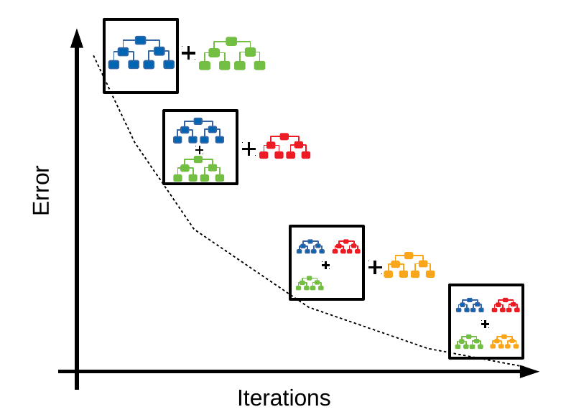
Boosting also grows multiple trees sequentially
Starts by growing one tree, extracting its residuals, then fitting a second tree to those residuals, etc.
Boosting can work well with very short trees. Trees with only one split (referred to as stumps).
Results in an additive model easy to interpret
We will examine the boosting regression trees while skipping the more complicated boosting classification trees
Notes:
Boosting is the final technique we will discuss in this module. Boosting also grows multiple trees sequentially. Starts by growing one tree, extracting its residuals, then fitting a second tree to those residuals, etc. Boosting literally boosts the predictive power iteratively in areas where the previous trees performed poorly. A salient feature is that it can work well with very short trees. That often involves trees with only one split (referred to as stumps). Boosting results in an additive model easier to interpret.
The algorithms behind boosting are complicated so we won’t discuss them in detail. We invite you to consult James, et. al. Introduction to Statistical Learning for a more thorough coverage of the algorithms.
So instead of using the predicted values from the previous tree, it is using the residuals.

Slide 53
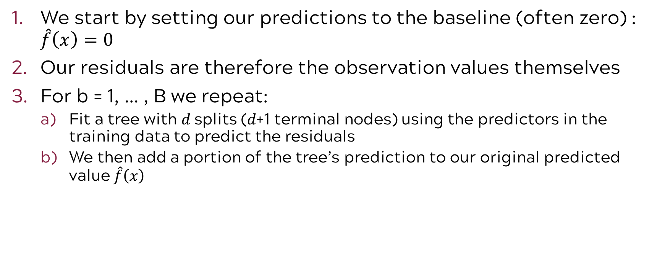
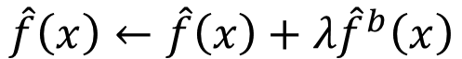
Boosting steps
We start by setting our predictions to the baseline (often zero) : $\hat{f}\left(x\right)=0$
Our residuals are therefore the observation values themselves
For b = 1, … , B we repeat:
Fit a tree with 𝑑 splits (𝑑+1 terminal nodes) using the predictors in the training data to predict the residuals
We then add a portion of the tree’s prediction to our original predicted value $\hat{f}\left(x\right)$
$$\hat{f}\left(x\right)←\hat{f}\left(x\right)+λ{\hat{f}}^{b}\left(x\right)$$
prediction from current tree
new prediction
the shrinkage parameter, this controls how much information your new prediction extracts from the new tree, essentially how fast your model learns
old prediction
Notes:
Mathematically here’s what that looks like
So we have our new prediction here, lets say this is the third tree we are trying to make a prediction with, that is determined by the old prediction, so this would be from the first tree, which used just the actual y values as the residuals, added to this second term here which is the prediction from the current tree, the second tree, multiplied by a shrinkage parameter, which should be familiar as we’ve seen lambda used before as a shrinkage parameter for lasso, but here it is controlling how fast the model is learning from its current tree. A larger lambda will allow the model to learn from its previous predictions a lot faster, reducing error across trees at a faster rate, while a lower value here will slow that learning rate.

Slide 54
Boosting steps continued
c) We remove the contribution of our new tree from the original residuals, thus updating the residuals (i.e. we removed the portion of the residuals that our “shrunk” new tree just accounted for):
Repeating this process B times will result in the boosting model’s output:
new residual
$$r_{i}←r_{i}−λ{\hat{f}}^{b}\left(x\right)$$
old residual
$$\hat{f}\left(x\right)=\hat{f}\left(x\right)+\sum_{b=1}^{B}{λ{\hat{f}}^{b}\left(x\right)}=\sum_{b=1}^{B}{λ{\hat{f}}^{b}\left(x\right)}$$
$$=$$
$$0$$
Notes:
Next, we are removing the contribution of our new tree from the original residuals, updating the residuals, and then the algorithm repeats this process B times resulting in the final model output.

Slide 55
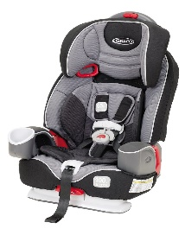
Exercise: Predict child car seat sales using regression trees and bagging
Simulated dataset containing sales of child car seats at 400 different stores
Sales (response): Unit sales (in thousands) at each location
CompPrice: Price charged by competitor at each location
Income: Community income level (in thousands of dollars)
Advertising: Local advertising budget for company at each location (in thousands of dollars)
Population: Population size in region (in thousands)
Price: Price company charges for car seats at each site
ShelveLoc: A factor with levels Bad, Good and Medium indicating the quality of the shelving location for the car seats at each site
Age: Average age of the local population
Education: Education level at each location
Urban: A factor with levels No and Yes to indicate whether the store is in an urban or rural location
US: A factor with levels No and Yes to indicate whether the store is in the US or not

Slide 56
ML paradigm to evaluate model performance
Test Error: average error that results from using a machine learning method to predict the response on data that was not used in training the method
Models are built to do well on the data they’ve been fed. We want to ensure they also do well on data they haven’t encountered.
Whole Sample
Randomly
divide
Training set
Fit
Model
Prediction
Validation set
Tune
Test
Test Error
Test set
Notes:
Before we jump into the exercise, recall the ML paradigm to evaluate model performance with test error
A common way to evaluate its performance in this paradigm is through test error. The model is used to make predictions on the test set, which the model has not yet “seen”, and from these predictions we can get test error. Test error is the average error that results from using a machine learning method to predict the response on data that was not used in training the method. Remember, the model was only built using the training and validation sets, thus it was built to do well on that data. We want to ensure the model will also do well on new data, which is why a test set is used.
Recall for the purposes of this course, we will limit ourselves to training and test (exclude validation)

Slide 57
Code road map
1) Import Modules + Packages
2) Visualize Data
3) Build Training + Test Datasets
4) For each model:
Fit model with training data
Generate predicted labels
Evaluate performance
Notes:
Also recall our code rode map

Slide 58
1) After our usual process of splitting the data, Fit a regression tree to the training set. Plot the tree, and interpret the results. What test error rate do you obtain?
R Code
fitting the tree
tr <- tree(Sales ~ ., data = Carseats[train, ])
summary(tr)
plot(tr)
text(tr, pretty = 0, digits = 2, cex = 0.8)
carseats_mse <- function(model) {
p <- predict(model, newdata = Carseats[!train, ])
mean((p - Carseats[!train, "Sales"])^2)
carseats_mse(tr)
summary of the tree model
plotting the tree
function to calculate MSE
for the model on the test set
Computing MSE
Python Code
fitting the tree
tree_reg = DecisionTreeRegressor(random_state=42)
tree_reg.fit(X_train, y_train)
plt.figure(figsize=(20,10))
tree.plot_tree(tree_reg, filled=True, feature_names=X.columns)
plt.show()
y_pred = tree_reg.predict(X_test)
mse = mean_squared_error(y_test, y_pred)
print(f'MSE: {mse}')
plotting the tree
Applying the model to test data
Compute and print MSE

Slide 59
2) Use cross-validation in order to determine the optimal level of tree complexity. Does pruning the tree improve the test error rate?
R Code
Python Code
depths = range(1, 21)
cv_scores = [cross_val_score(DecisionTreeRegressor(max_depth=d, random_state=42),
X_train, y_train, cv=10, scoring='neg_mean_squared_error').mean()
for d in depths]
best_depth = depths[np.argmax(cv_scores)]
print(f'Optimal tree depth: {best_depth}')
pruned_tree = DecisionTreeRegressor(max_depth=best_depth, random_state=42)
pruned_tree.fit(X_train, y_train)
y_pred_pruned = pruned_tree.predict(X_test)
mse_pruned = mean_squared_error(y_test, y_pred_pruned)
print(f'Pruned Tree MSE: {mse_pruned}')
Cross validation
res <- cv.tree(tr)
plot(res$size, res$dev, type = "b", xlab = "Tree size", ylab = "Deviance")
min <- which.min(res$dev)
abline(v = res$size[min], lty = 2, col = "red")
ptr <- prune.tree(tr, best = 8)
plot(ptr)
text(ptr, pretty = 0, digits = 2, cex = 0.8)
carseats_mse(ptr)
Cross-validation to find the optimal tree depth
plotting the deviance of each tree size
Prune the tree to and plot the pruned tree
Fit and plot the pruned
tree
Compute MSE
Compute
and print MSE

Slide 60
3) Use the bagging approach in order to analyze this data. What test error rate do you obtain? Use the `importance()` function to determine which variables are most important.
R Code
Python Code
Building
the bagging model
bagged <- randomForest(Sales ~ ., data = Carseats[train, ], mtry = 10, ntree = 200, importance = TRUE)
carseats_mse(bagged)
importance(bagged)
bagging_reg = RandomForestRegressor(n_estimators=200, max_features=X_train.shape[1], random_state=42)
bagging_reg.fit(X_train, y_train)
y_pred_bagging = bagging_reg.predict(X_test)
mse_bagging = mean_squared_error(y_test, y_pred_bagging)
print(f'Bagging MSE: {mse_bagging}')
feature_importances = bagging_reg.feature_importances_
print(feature_importances)
Building
the bagging model
Compute MSE
prediction
Compute MSE
Display the importance of each predictor
Display the importance of each predictor

Slide 61
4) Use random forests to analyze this data. What test error rate do you obtain? Use the `importance()` function to determine which variables are most important. Describe the effect of the number of variable considered at each split, on the error rate obtained.
R Code
Python Code
Building
the random forest model
rf <- randomForest(Sales ~ ., data = Carseats[train, ], mtry = 3, ntree = 500, importance = TRUE)
carseats_mse(rf)
importance(rf)
Building
the random forest model
rf_reg = RandomForestRegressor(n_estimators=500, max_features=3, random_state=42)
rf_reg.fit(X_train, y_train)
y_pred_rf = rf_reg.predict(X_test)
mse_rf = mean_squared_error(y_test, y_pred_rf)
print(f'Random Forest MSE: {mse_rf}’)
feature_importances_rf = rf_reg.feature_importances_
print(feature_importances_rf)
Compute MSE
prediction
Compute MSE
Display the importance
of each
predictor
Display the importance
of each
predictor

Slide 62
Tree-Based Methods

Slide 63
Introduction to Machine Learning Course Roadmap
What is the goal of the data analysis?
Predict an output |  |  |  |  |  | Reveal patterns or relationships |  | Make decisions using an autonomous agent
Supervised Learning (Output in the data set) |  |  |  |  |  | Unsupervised Learning (No output in the data set) |  | Reinforcement Learning* (Supervised & unsupervised)
Continuous or discrete output? |  |  |  |  |  | What is the subgoal? |  | Does a model exist?
Continuous |  |  | Discrete |  |  | Identify groups | Reduce dimensions | Model Based | Model Free
Simple linear regression Multiple linear regression Subset selection Ridge regression & LASSO PCR & PLS | Polynomial regression Step functions Splines Local regression General additive models | Decision tree Random forest Neural network Gradient boosting tree | Logistic regression Linear discriminant analysis Quadratic discriminant analysis | Decision tree Random forest Neural network Gradient boosting tree | Support vector machines | Hierarchical clustering K-means clustering | Principal components analysis | Given the model Learn the model | Policy Optimization Q-Learning
Decision tree
Random forest
Decision tree
Random forest
Gradient boosting tree
Gradient boosting tree
*Advanced Topic: Bonus module if time
Notes:
In the previous module, we discussed supervised learning with a discrete or categorical response. Specifically we looked at parametric approaches for classification. Now we are going to look at nonparametric tree-based methods. Interestingly enough, tree-based methods are applicable for both “classification” with categorical outcomes and “regression” with continuous outputs .

Slide 64
Now you should be able to:
Identify when tree-based methods could be used
Describe the general ideas behind growing and pruning a tree
Describe the problem of overfitting
Understand the basic idea behind cost-complexity pruning
Define classification error and entropy
Describe the general procedures for bagging, random forests, and boosting
Implement basic tree-based methods in Python

